Slide 1
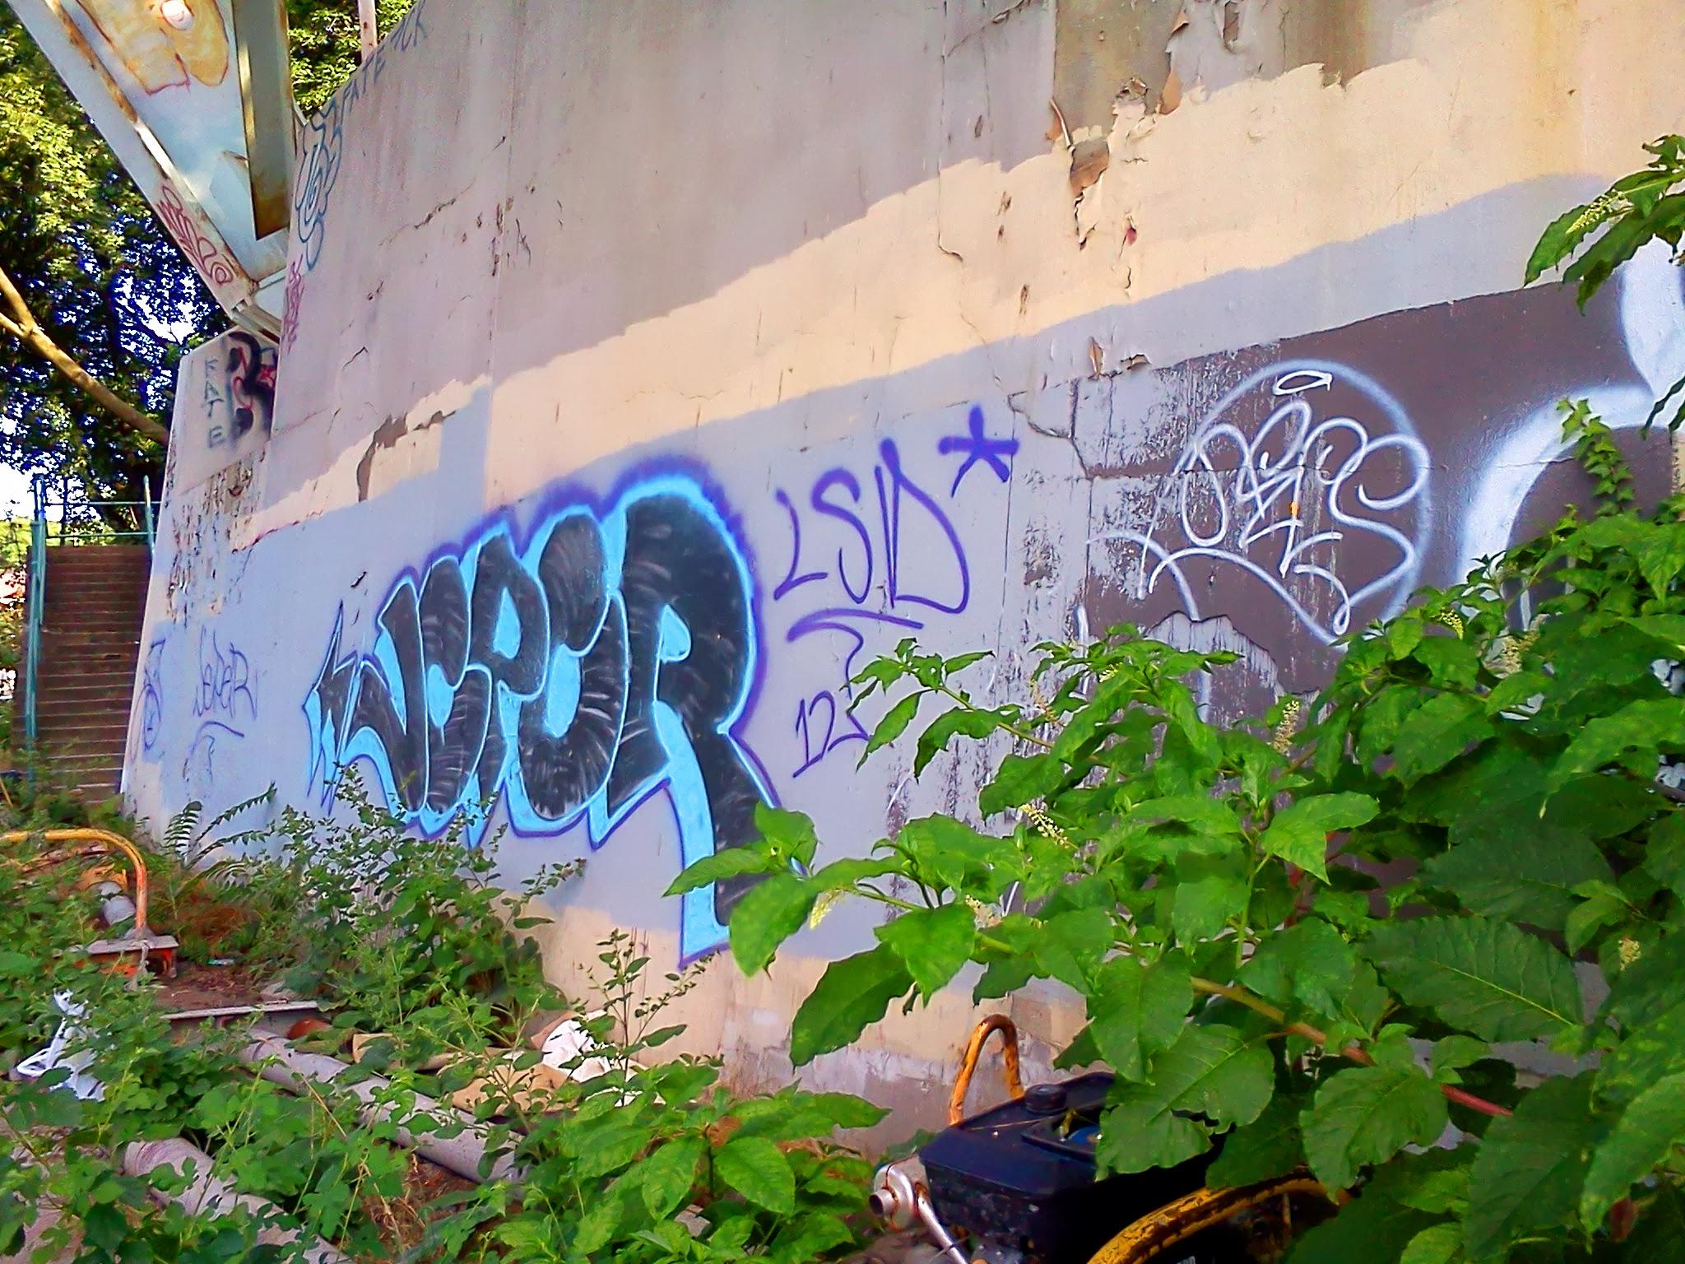
NETENTION
NEIGHBORHOOD
surveillance, supply, security, statistics, status, simplicity
self-sufficiency

Slide 2
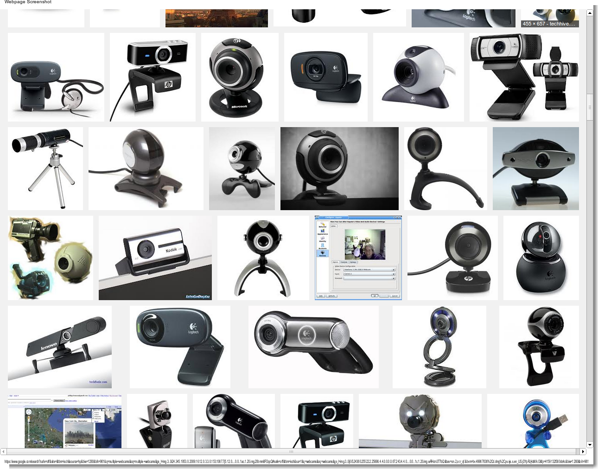
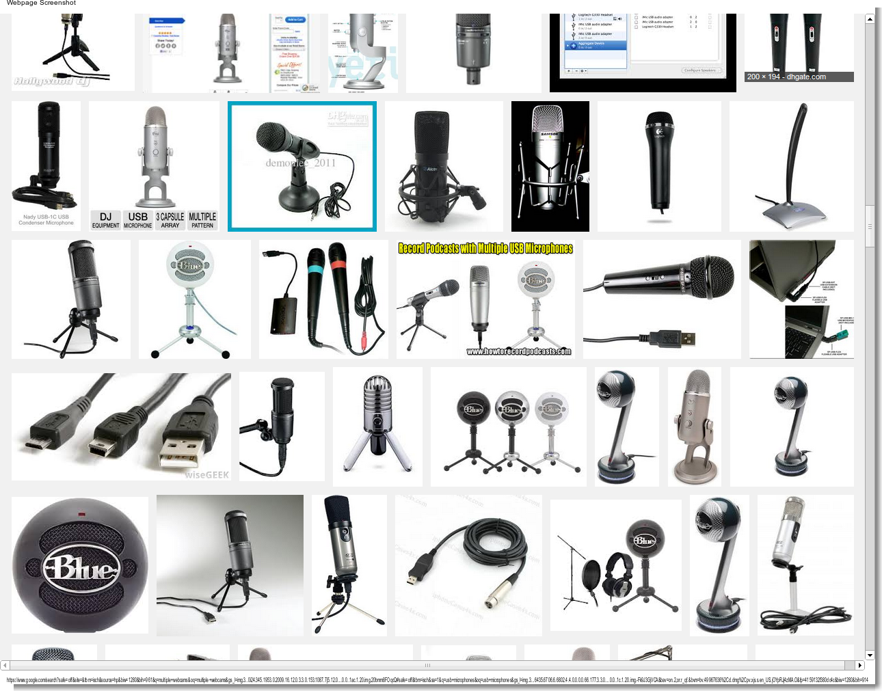
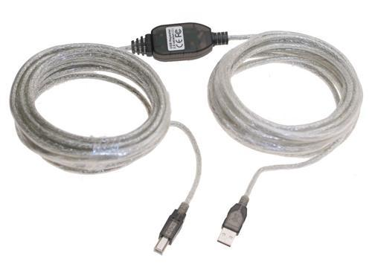
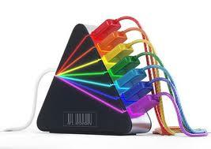
INPUT
webcams
microphones
...other sensors
OUTPUT
...nobjects

Slide 3
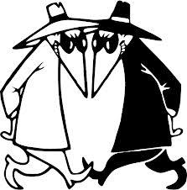
SOUSVEILLANCE inverse-surveillance
Sousveillance involves community-based recording and measuring of environmental phenomena, such as your government.
READ MORE:
http://en.wikipedia.org/wiki/Sousveillance
http://hplusmagazine.com/2011/05/23/david-brin-on-the-path-to-positive-sousveillance/
http://www.acceleratingfuture.com/people-blog/2009/is-sousveillance-the-best-path-to-ethical-agi/

Slide 4
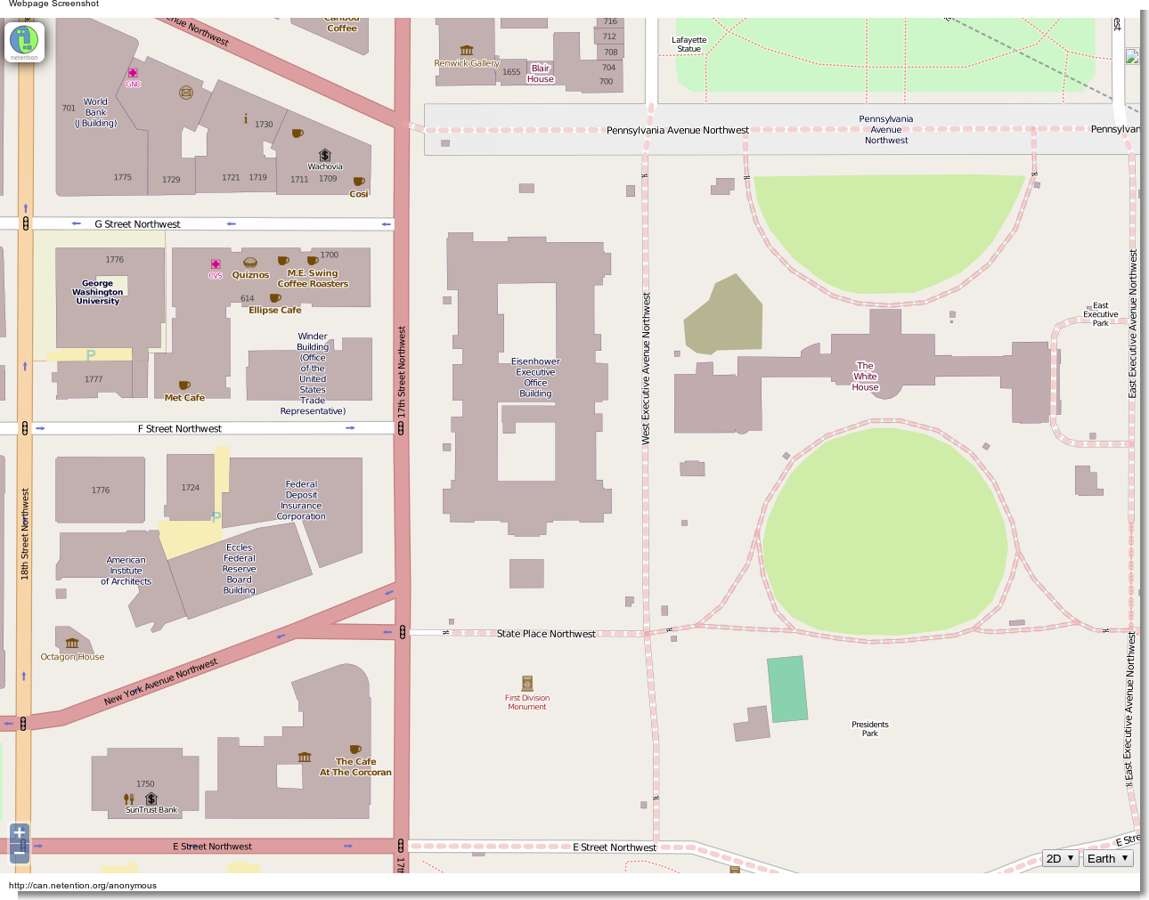

Slide 5

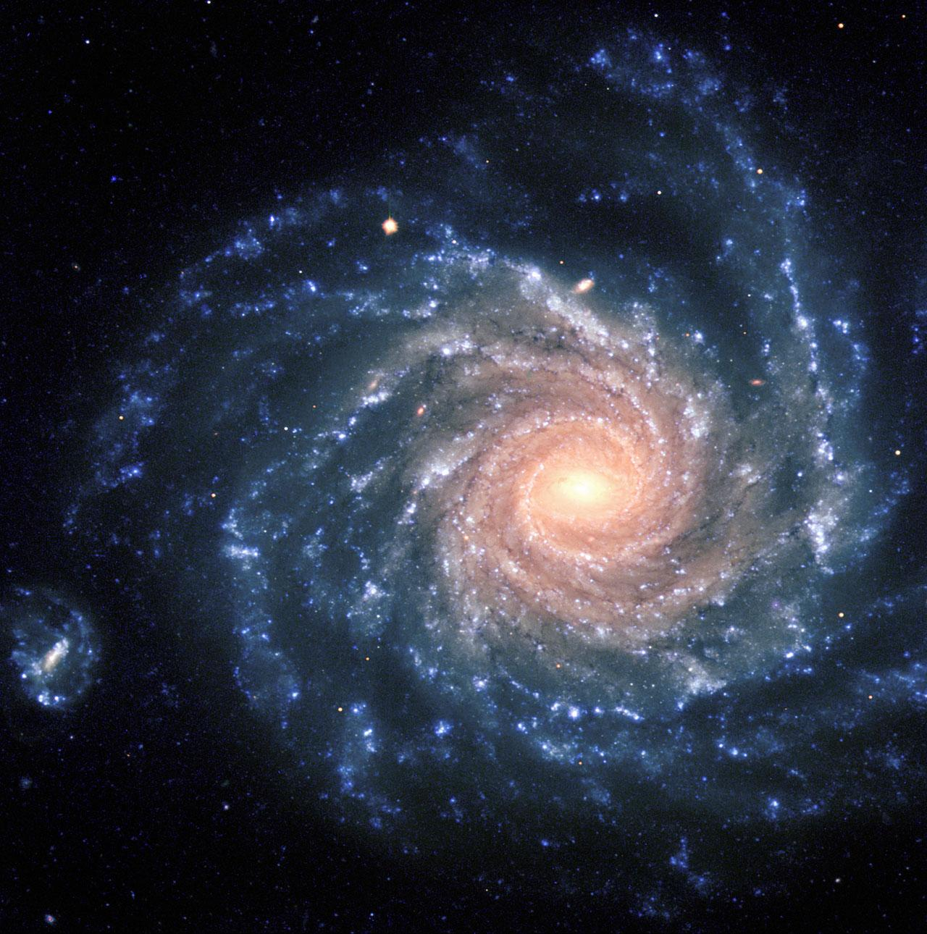
4D SPACETIME ENVIRONMENT MODEL
Inter-connected datapoints (knowbjects) with metadata
GPS
Structure in Motion (PhotoSynth) - multiple camera input -> animated 3D model
Auto-forget “uninteresting” history segments to conserve memory
Notes:
NOTES:
http://www.cs.cornell.edu/~snavely/bundler/
https://code.google.com/p/pixelstruct/
http://en.wikipedia.org/wiki/UIMA

Slide 6
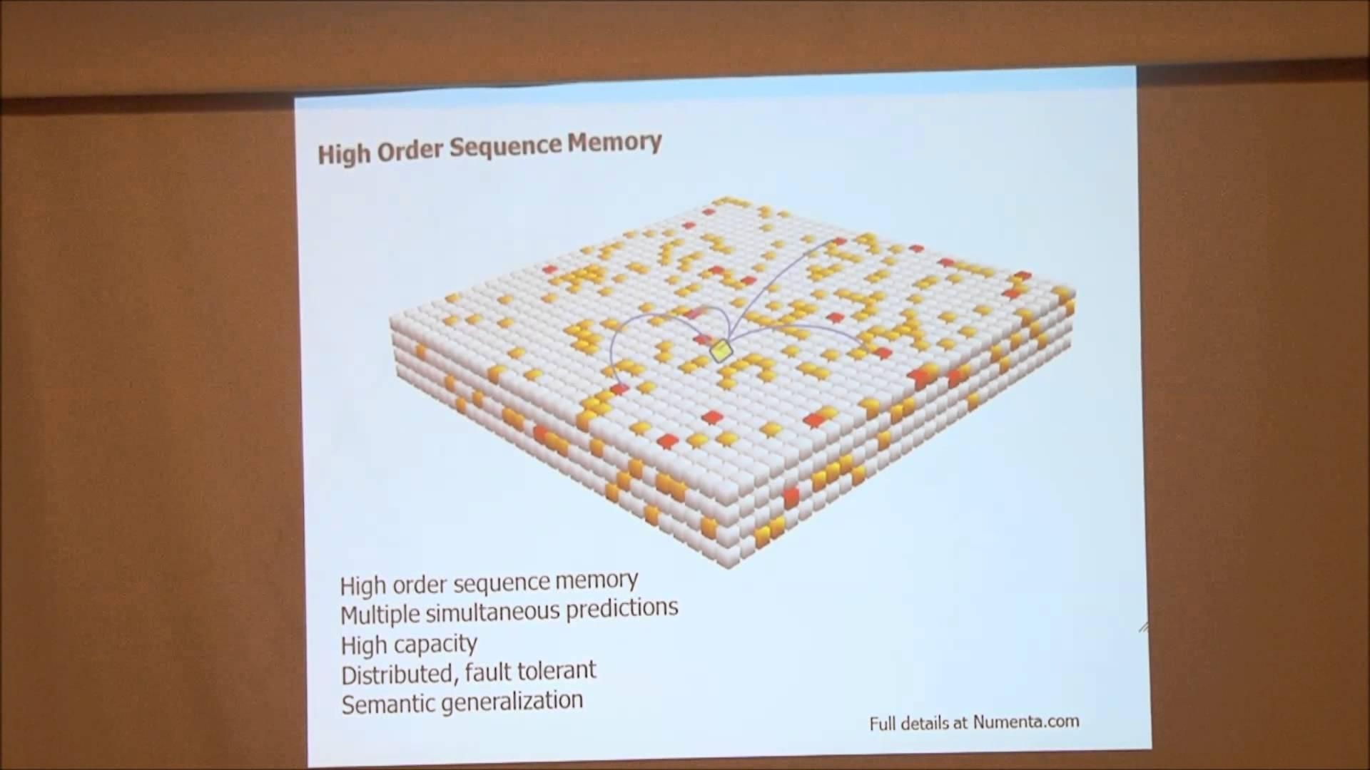
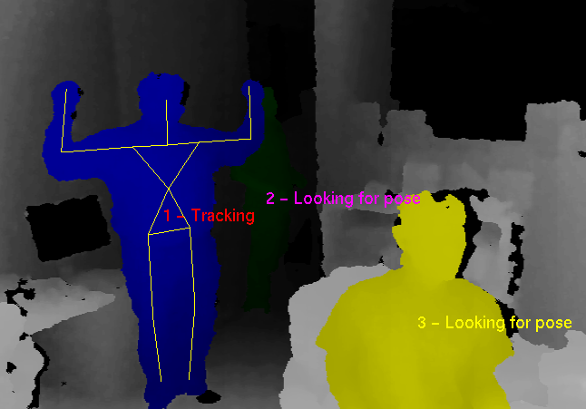
RECOGNIZE & TRACK
what it is
who it is (and their public online identity)
where it goes
where it looks

Slide 7
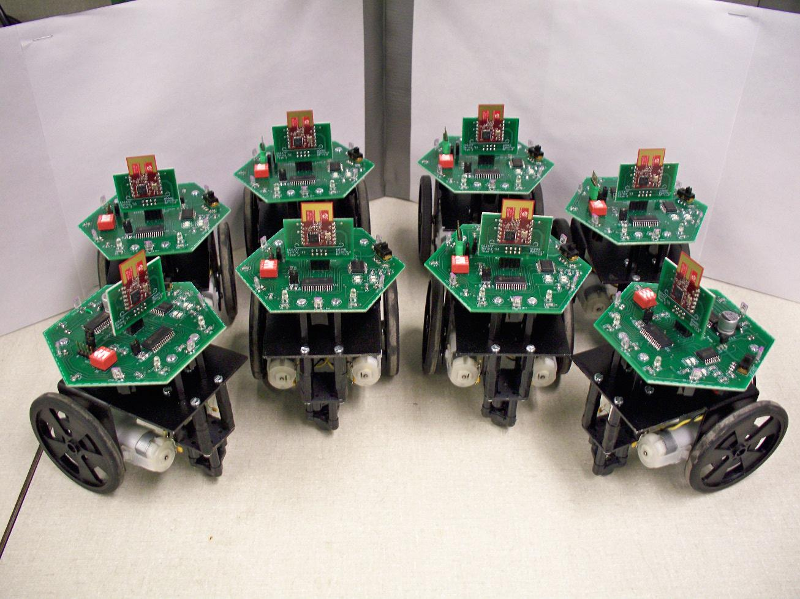
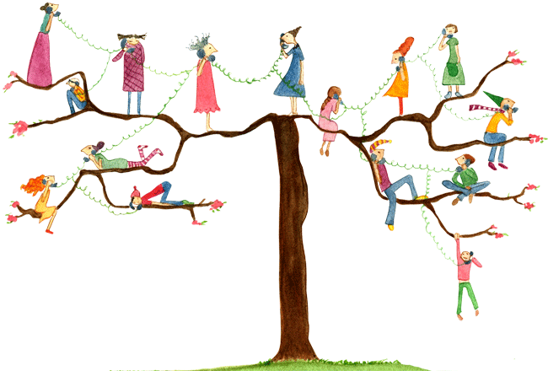
REACT
Generate alerts and reports
Activate/deactivate actions
Access web services
Contact via IM, e-mail, phone, SMS

Slide 8
DELIVERY NETWORK
When excess or lack-of are detected, a delivery can be scheduled
Operates across a wide range of robot devices capable of safely carrying different sizes and weights of packages certain distances

Slide 9
ANIMAL COLLAR NETWORK
Various sensors
  Camera
  Microphone
  Accelerometer
  GPS
Minimal wireless transmission (avoid electrosmog)
USB hub for download (at end of day)
Solar or battery powered
Doesn’t involve invasive surgery or implants

Slide 10
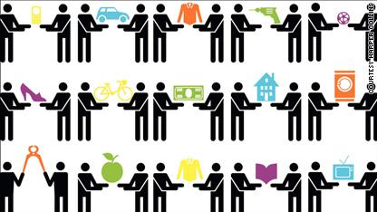
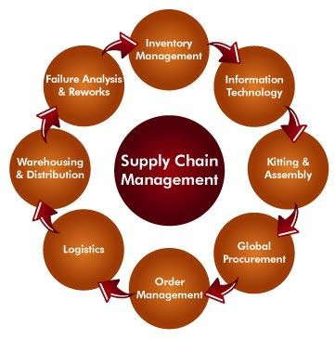
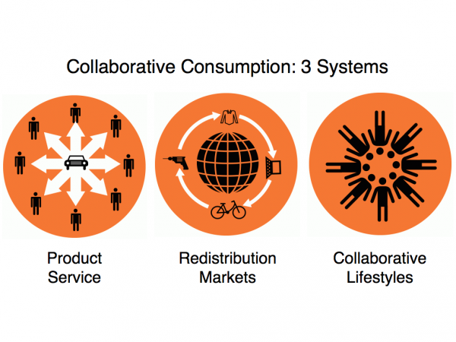
RESOURCE INVENTORY
Collaborative Consumption
Services / Items Desired (Imaginary Items)
Services / Items for Sale or Exchange
Supply Chain: Scheduled Shopping Lists (+recurring)
Notes:
EAD MORE:
htREAD MORE:
http://www.sensorica.co/
http://edgeryders.eu/economy-app
http://www.lulu.com/shop/david-pinto/pulse/paperback/product-5409152.html
[add others]
http://www.sensorica.co/
http://edgeryders.eu/economy-app
http://www.lulu.com/shop/david-pinto/pulse/paperback/product-5409152.html

Slide 11
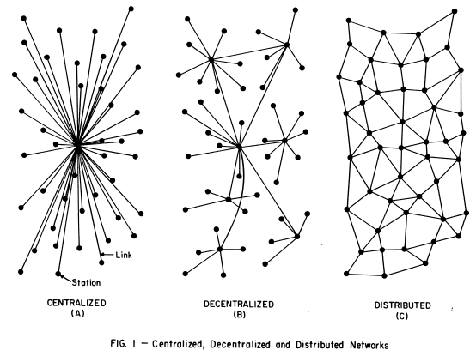
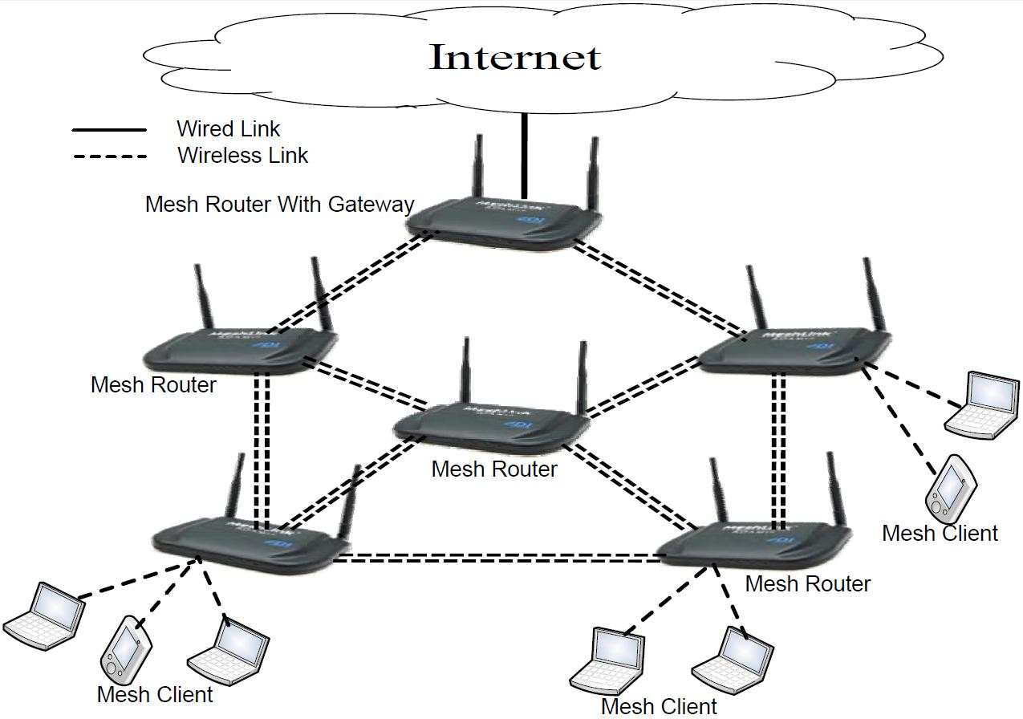
MESH INTERNET
Suggests best hardware and software options
Monitors link quality

Slide 12
OUTPUT
Web interface
Share with neighbors
  stray animal census
  collect evidence
  investigate crime
Sonification (make data streams audible)
Colors and Sounds
  can be learned by animals
    [picture of shuka watching security cam]

Slide 13
TECHNOLOGY IMPLEMENTATION
Netention (web interface)
dANN (AI algorithms)
OpenCV / Node-OpenCV
  https://github.com/peterbraden/node-opencv
Predator
  https://github.com/zk00006/OpenTLD
NuPic (Object recognition)
Bundler (Cameras -> 3D scene)
Linux (stable platform with access to a wide array of peripherals)
Robot Operating System (ROS)

Slide 14
Open-Source Home Security
motion - video motion capture daemon (1)
LinuxMCE - home automation and media player (uses ‘motion’)
ZoneMinder - web-controlled home security (w/ motion detection)
iSpy - Windows-based home surveillance
Other projects

